Slide 1
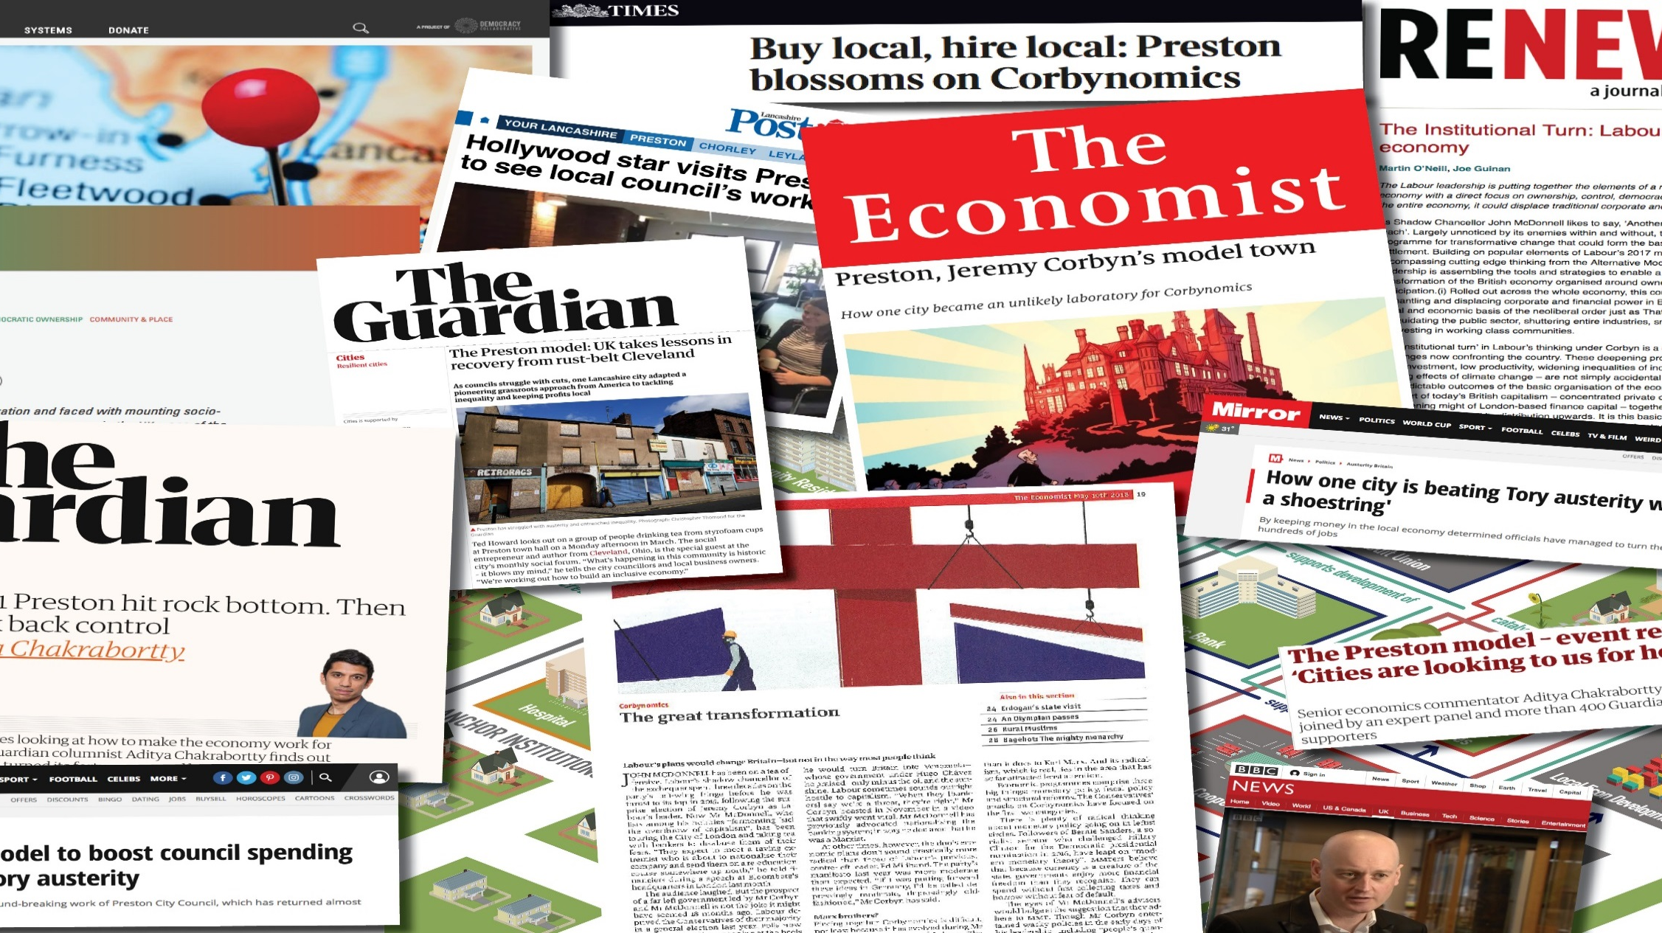
Building Community Wealth in Preston and across the UK

Slide 2
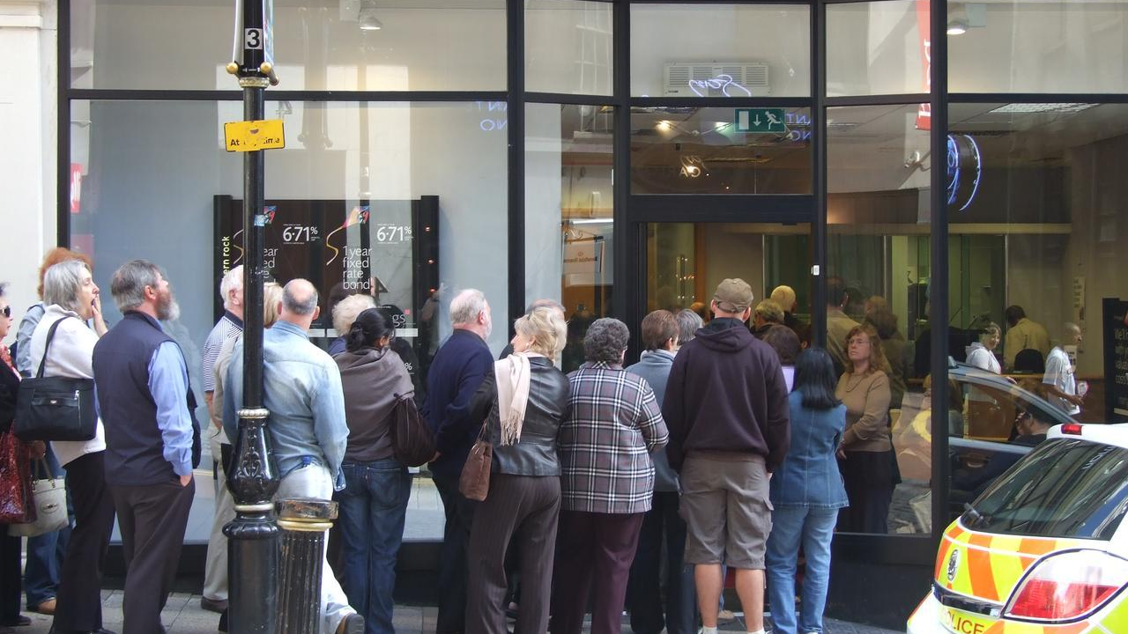
The Great Recession of 2007/8 onwards

Slide 3

Consequences of the crash of 2008 and accompanying austerity
Huge amounts of public money has had to go into bailing out the financial system.
Austerity measures mean continuing squeeze on most of population, despite some increase in jobs and modest growth.
Investment and productivity remain weak & bank lending to business is paltry.
Little sign of improvement in living standards and inequality continues to rise.
A systemic failure – the 21st century model of capitalism has failed – but not been replaced.
Current macro economic approaches seeking to prop a deformed system up – do not address inherent problems.

Slide 4
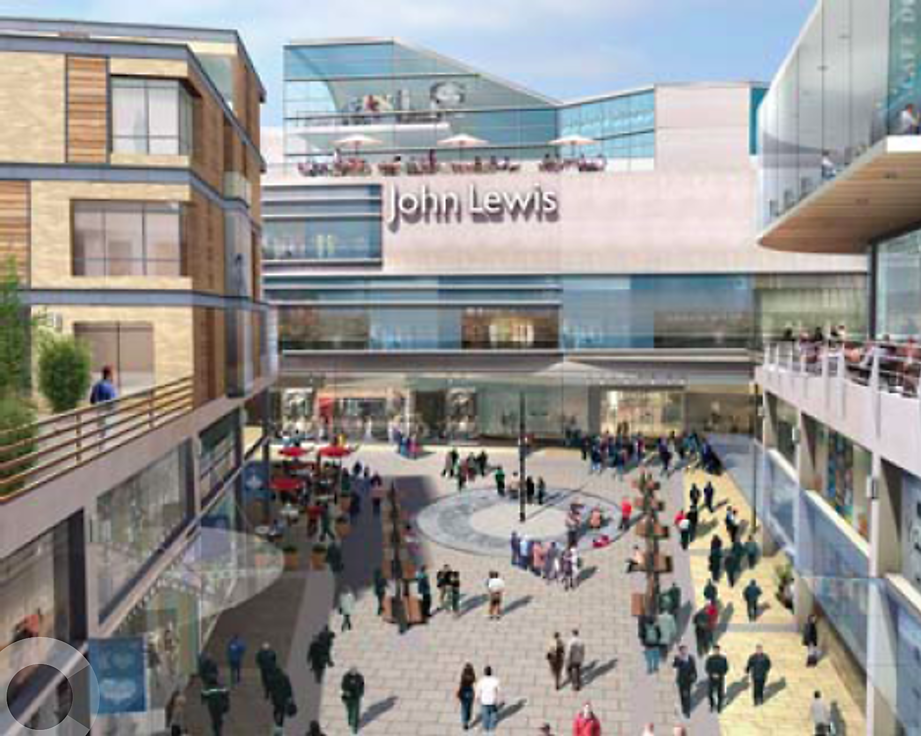
This systemic failure hits Preston with the abandonment of £700m Tithebarn Regeneration Scheme in 2011

Slide 5

A democratic economy now emerging in Preston based on common sense alternatives (1)
Our anchor institution strategy with CLES has large placed based institutions in Preston and Lancashire with a combined spend of nearly £1 billion per annum increasing spending to local suppliers to benefit our community and we encourage insourcing.
There is a £100m placed based investment by our local government pension fund in student flats, hotel and office space through City Deal we want to build on with a potential Lancashire Wealth Fund.
We are expanding worker owned cooperative businesses through an innovative partnership with Mondragon Cooperative Corporation, UCLan and Preston Cooperative Development Network.
We are looking to establish the North West Community Bank and support credit unions and our CDFI (Lancashire Moneyline).

Slide 6
A democratic economy now emerging in Preston based on common sense alternatives (2)
Preston City Council is working with the Living Wage Foundation to make Preston one of the UK’s first Living Wage Places.
We are promoting municipal ownership and enterprise of a major city centre development as part of our economic strategy.
We are establishing a housing delivery vehicle and looking at opportunities with other Lancashire councils to adopt a more prominent housing development role.
Our planning policies encourage locally based suppliers and labour on both public and private sector developments in the wider Preston economy.
Work with the University of Central Lancashire and partners is establishing a Civic Drone Centre exploring how the Preston Model approach can benefit the community including new drone supply chains and clusters and a civic drone service.

Slide 7
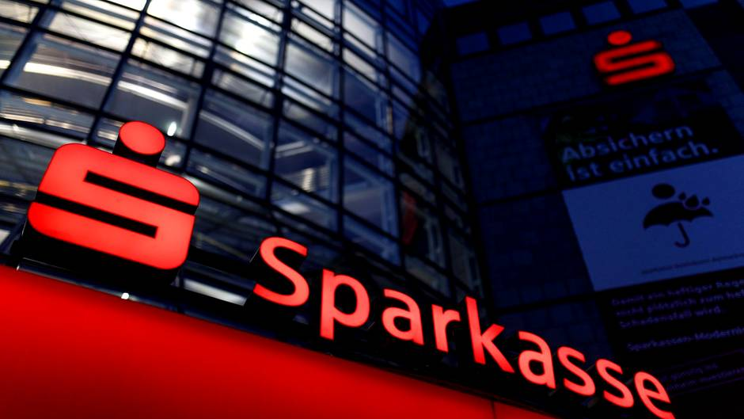
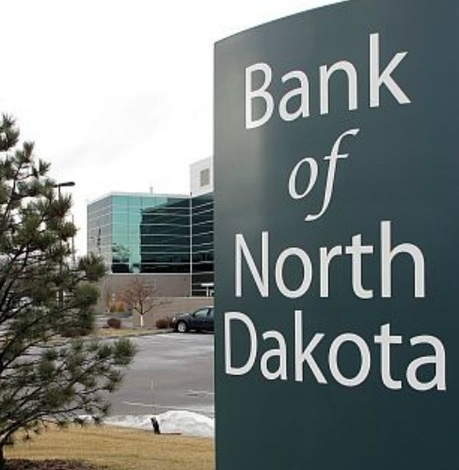
Public and community banking

Slide 8
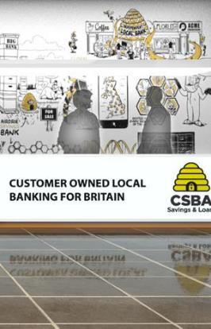
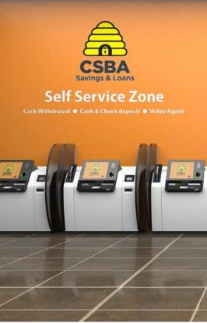
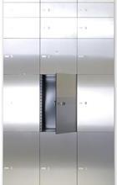
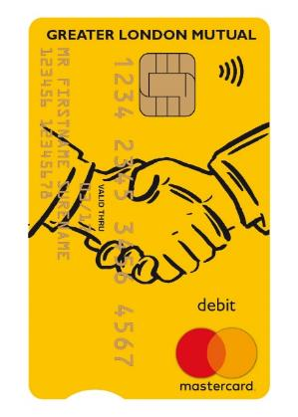


Community banking to serve the north west
Staffed branches
Satellite branches
Digital channels
Safe deposit box
Current accounts
NW Bank
NW BANK
NW Bank
Branch director with lending authority
Local knowledge
Most of what you can do in a staffed branch
Call centre video link
Extended opening
Web, mobile, tablet fully integrated
Automated safe deposit box service
High functionality
Simple & transparent charges: £5 personal, £10 business pcm

Slide 9
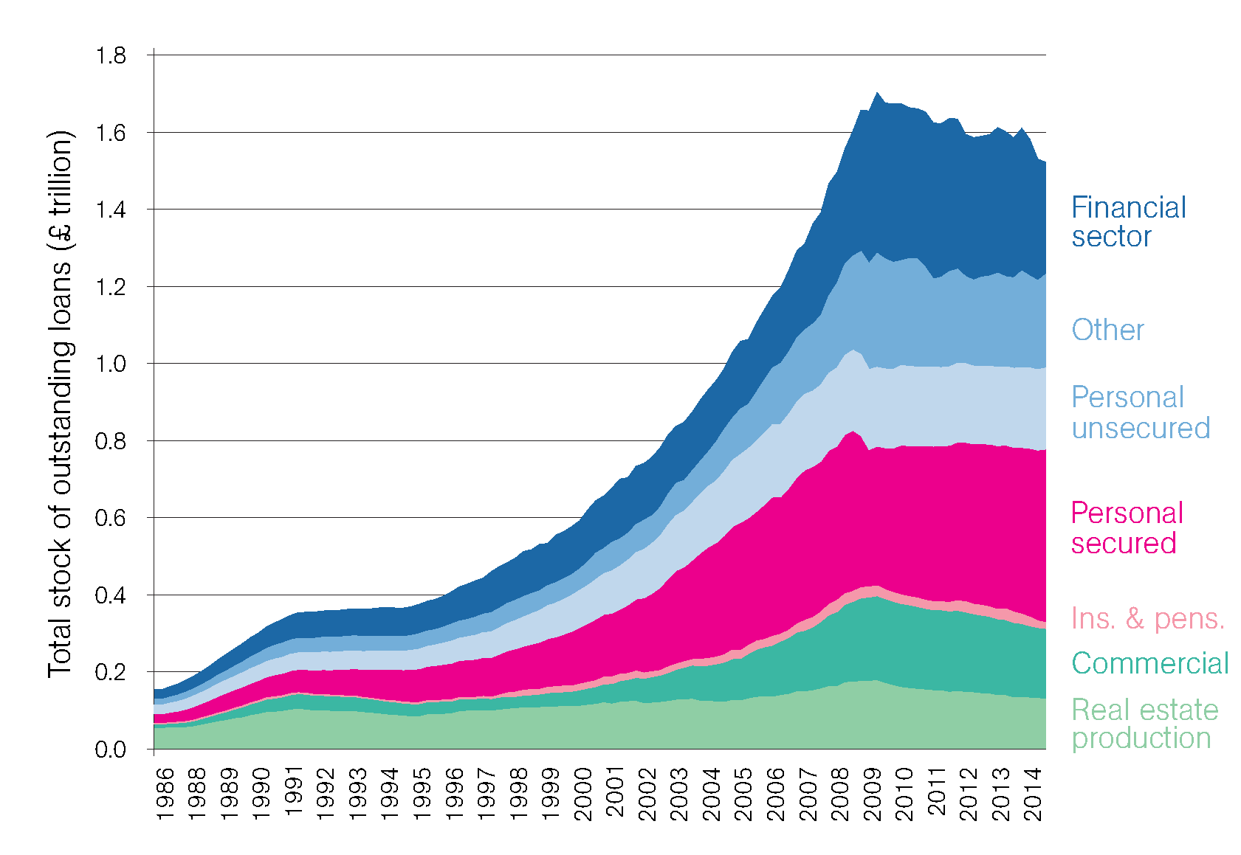
Who gets the loans now?
Big 4 Balance Sheets
SME Loans – North West

Slide 10
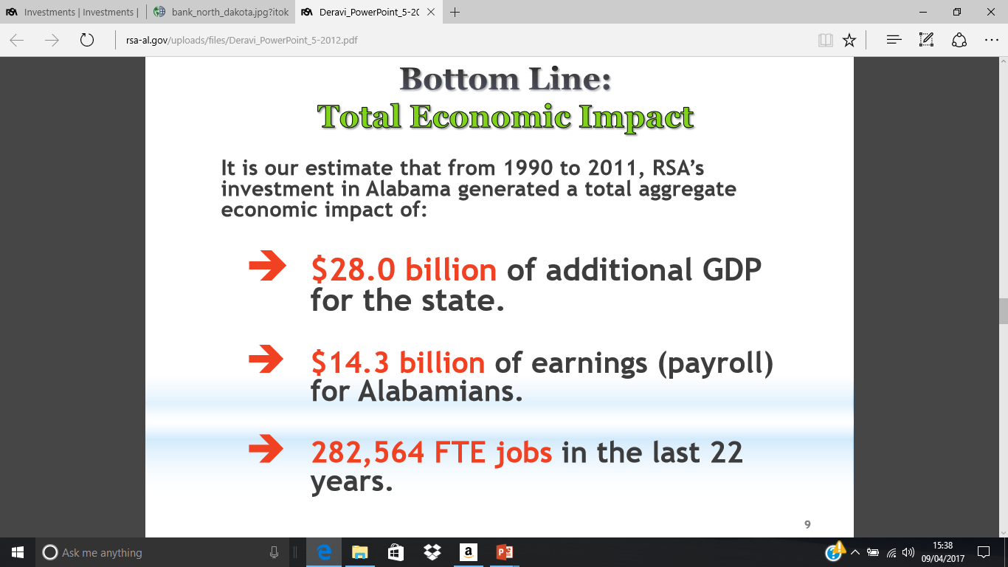

Investments in place (Retirement Systems of Alabama public pension fund)

Slide 11
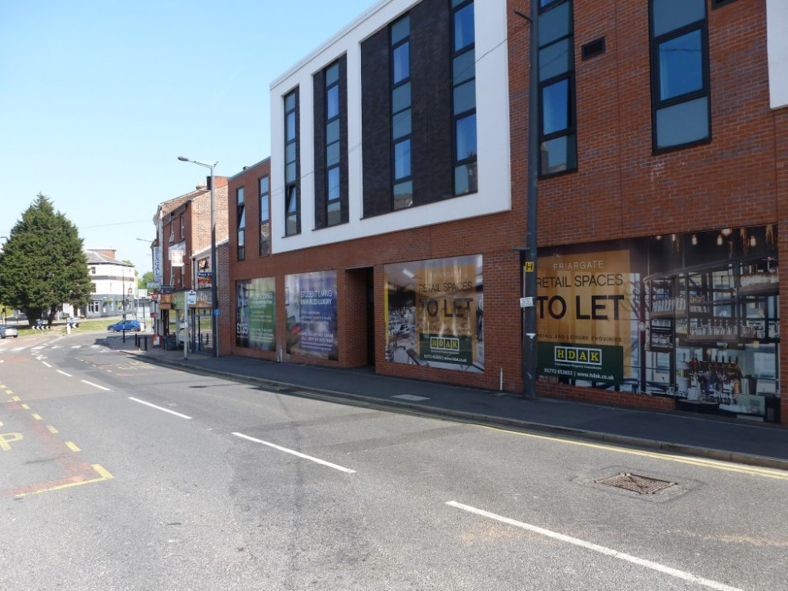
Public pension fund investments in place – Friargate Court, Preston

Slide 12
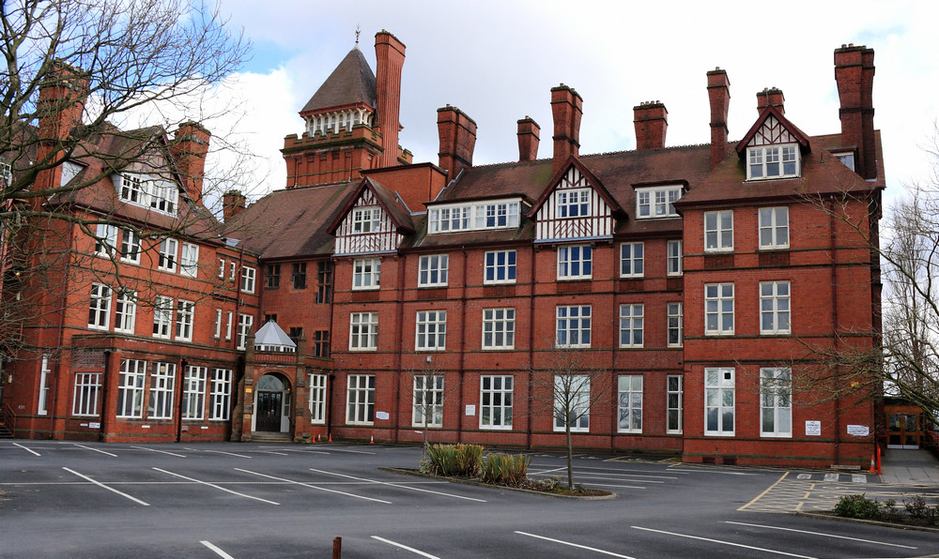
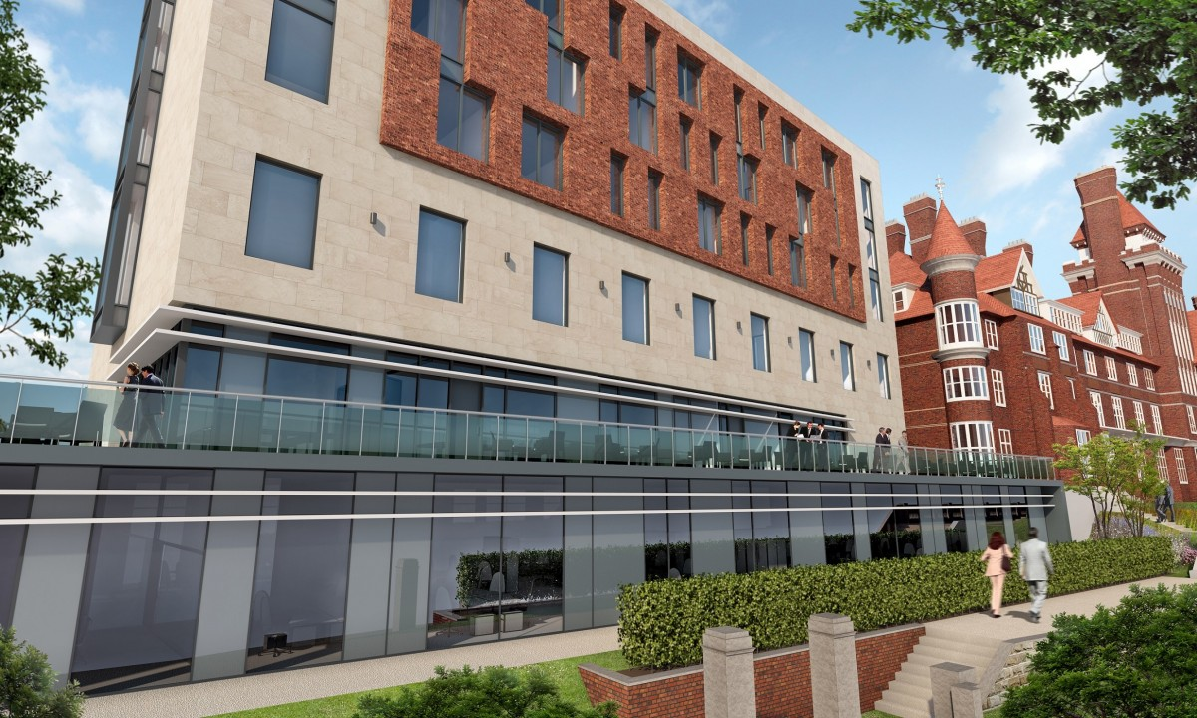
Public pension fund investments in place – Park Hotel, Preston

Slide 13
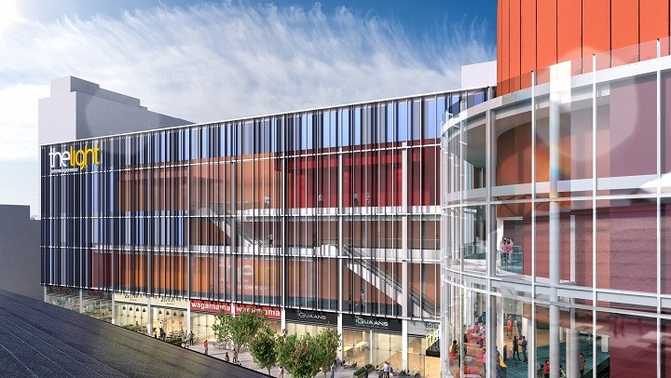
Municipal Ownership - Market Quarter Cinema Development

Slide 14
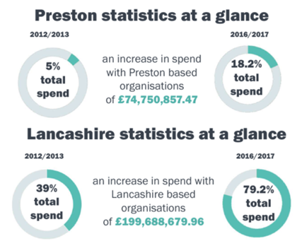
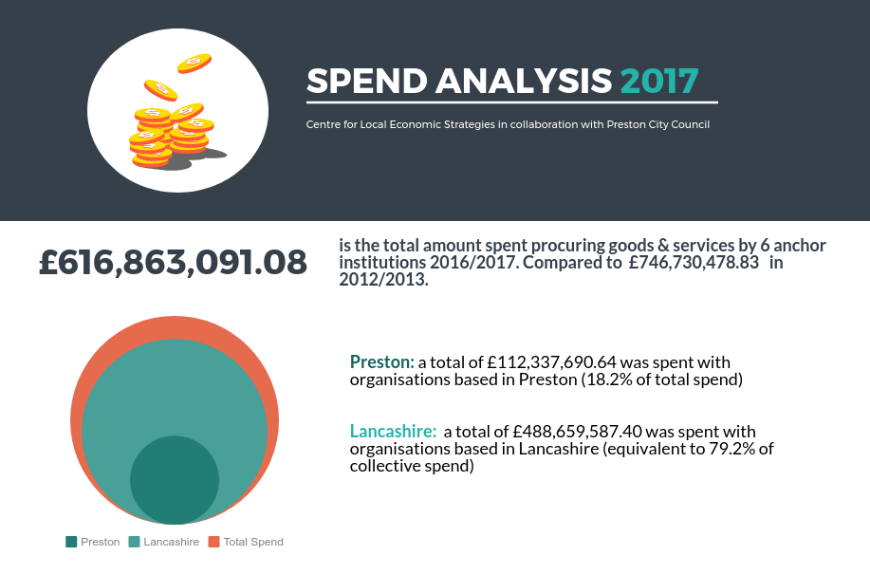
Public sector spend repatriated to Preston and Lancashire

Slide 15
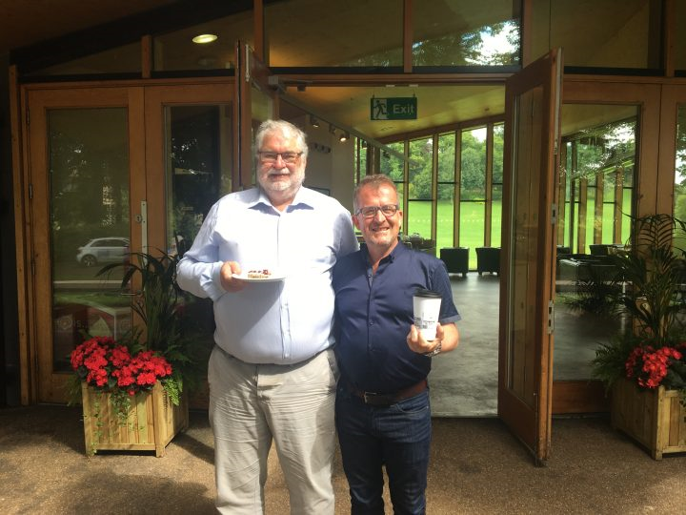

Slide 16
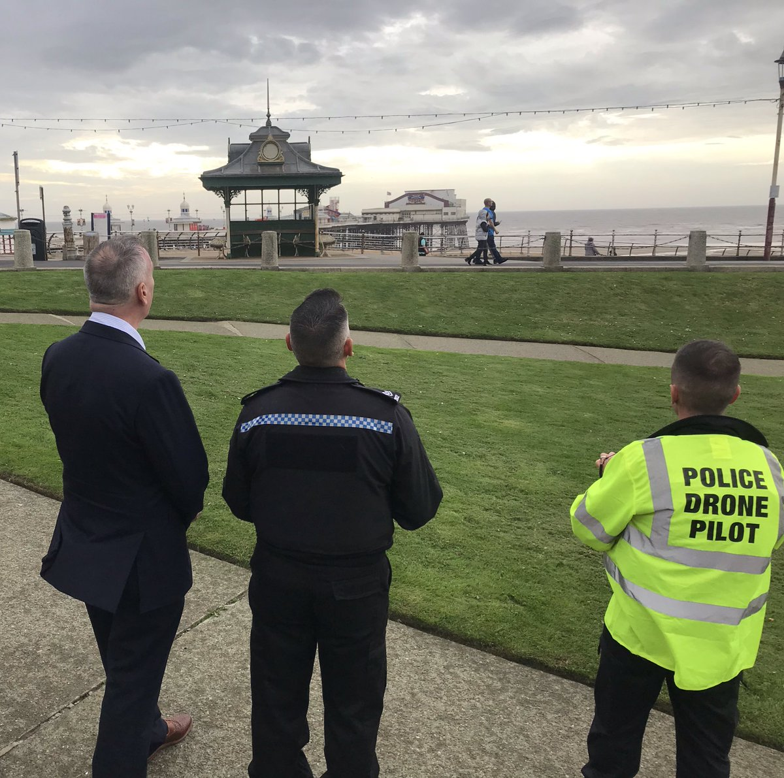
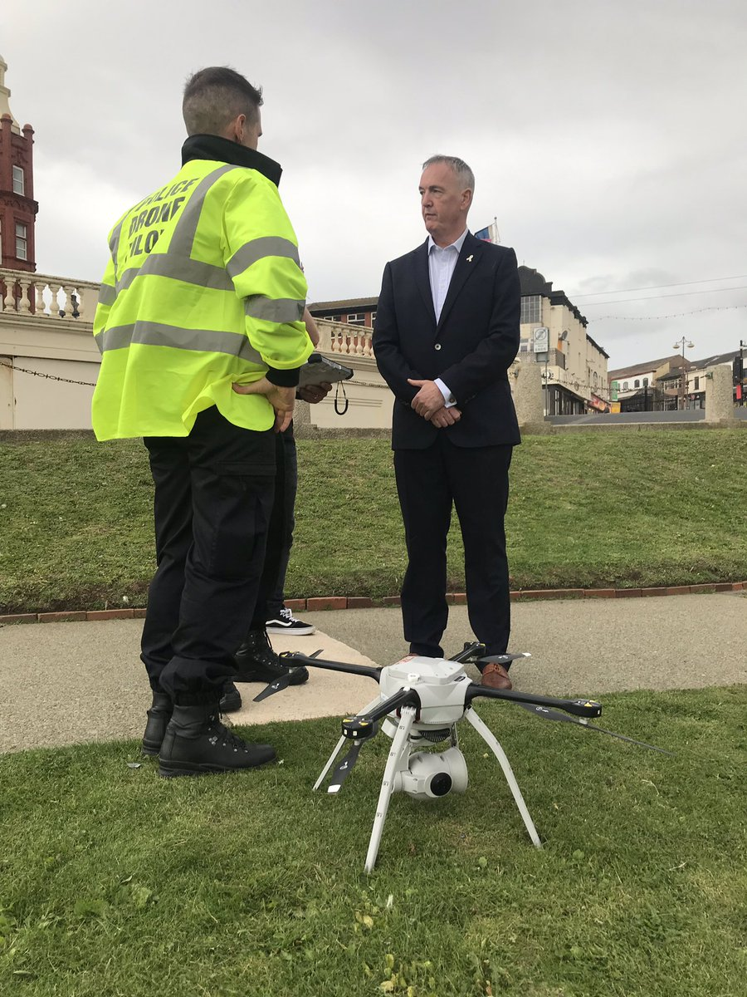

Slide 17

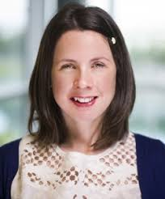

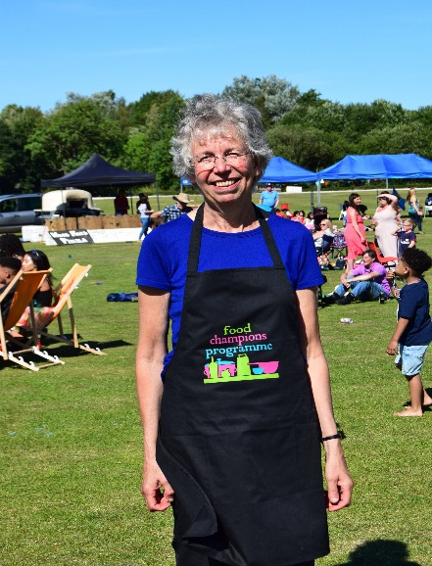
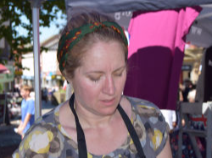

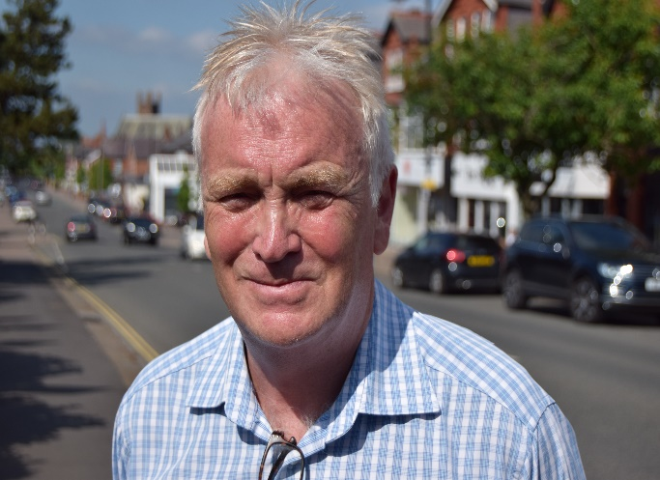
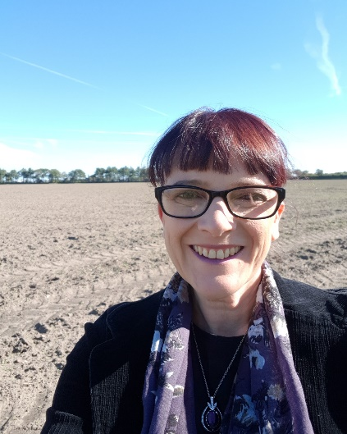
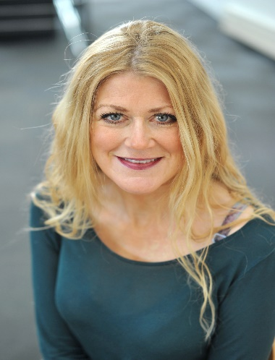
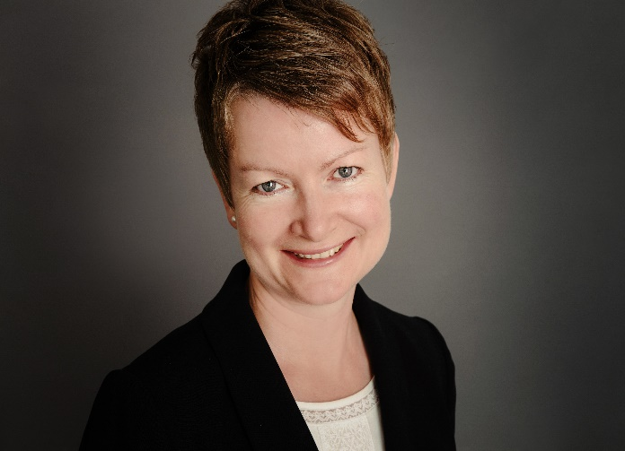


Slide 18
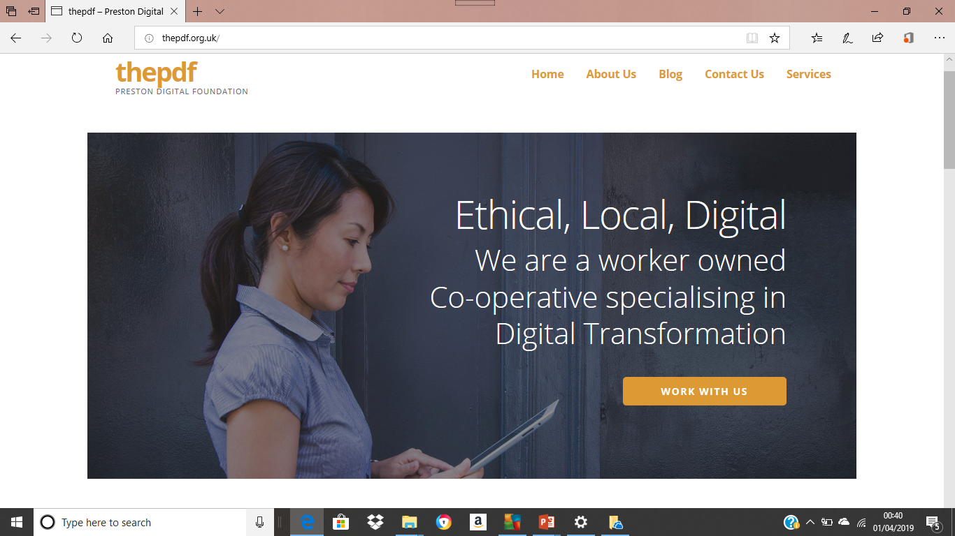

Slide 19





Slide 20
Median part time wage levels in Lancashire (workplace)
Part time wage levels – 2011 Part time wage levels – 2018
Preston | £143.60
Burnley | £149.10
Chorley | £141.20
Fylde | £161.80
Hyndburn | £138.20
Lancaster | £140.00
Pendle | £154.60
Ribble Valley | #
Rossendale | £117.20
South Ribble | £128.40
West Lancs | £142.80
Wyre | £140.70
North West | £152.60
Great Britain | £153.00
Preston | £212.10
Burnley | £178.30
Chorley | £189.40
Fylde | £192.80
Hyndburn | £174.20
Lancaster | £188.10
Pendle | £179.20
Ribble Valley | £169.30
Rossendale | £189.90
South Ribble | £177.20
West Lancs | £163.60
Wyre | £156.70
North West | £185.20
Great Britain | £187.30

Slide 21
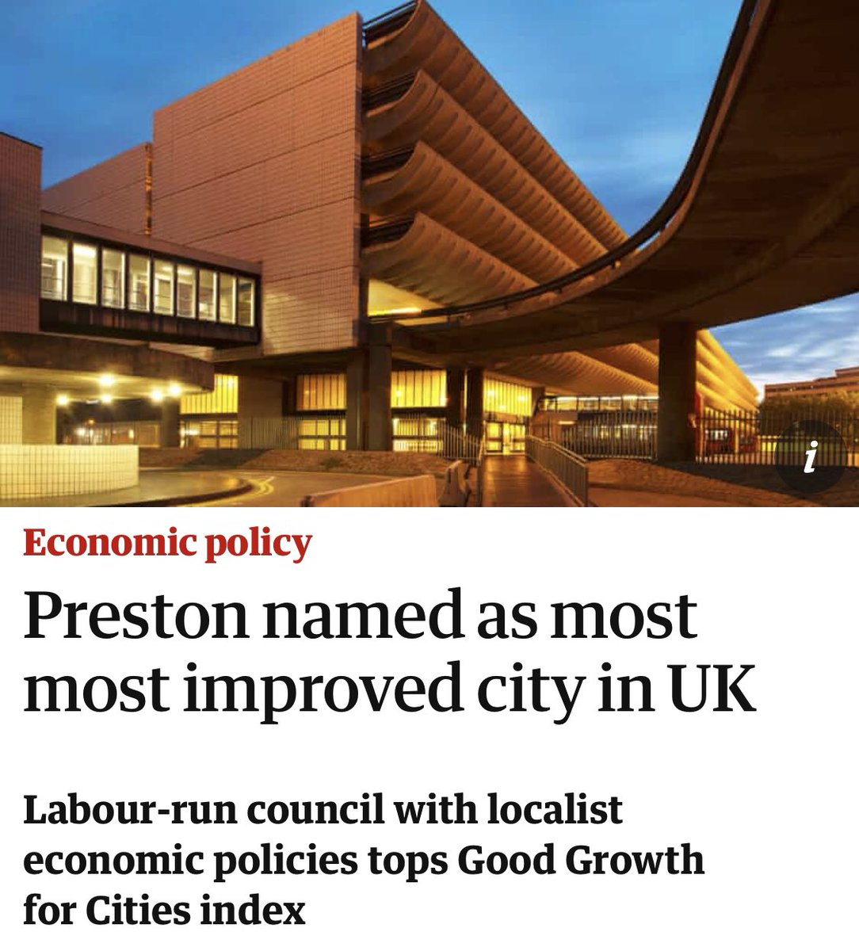

Slide 23
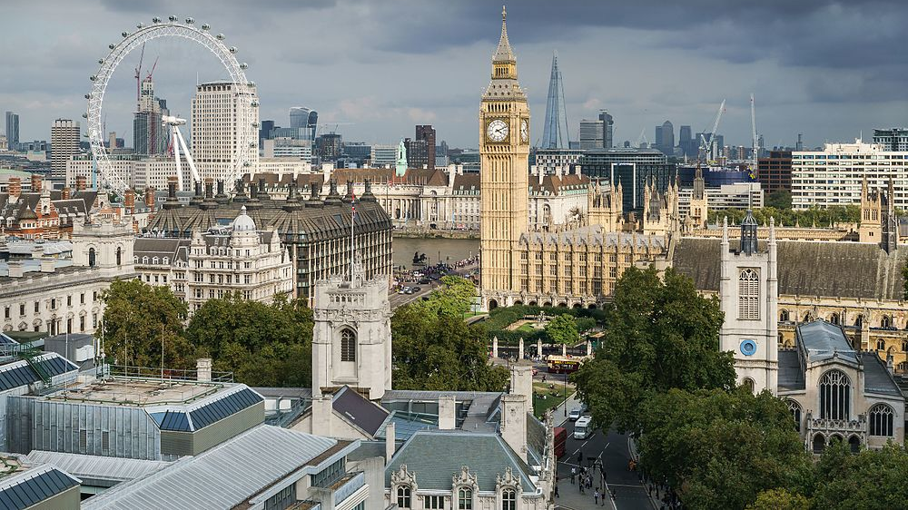
Building community wealth in the UK and overseas

Slide 24
Examples of Community Wealth Building in the United Kingdom
INSOURCING OF SERVICES WHEN POSSIBLE E.G. ISLINGTON & HARINGEY COUNCIL, LANCASHIRE CONSTABULARY POST CARILLION/CAPITA.
THE WELSH ASSEMBLY IS ESTABLISHING A WELSH COMMUNITY BANK TO COMPLIMENT THE WELSH DEVELOPMENT BANK.
PLYMOUTH AND OXFORD ARE COMMITTED TO DOUBLING THE SIZE OF THE COOPERATIVE ECONOMY. NORTH AYRSHIRE IS ENCOURAGING WORKER AND EMPLOYEE OWNERSHIP.
HACKNEY AND BIRMINGHAM HAS A MANIFESTO COMMITMENT TO ESTABLISH MUNICIPALLY OWNED ENERGY COMPANIES.
LONDON COUNCILS ARE SUPPORTING THE EXPANSION OF COMMUNITY LAND TRUSTS AND LOOKING TO INVEST PUBLIC PENSIONS IN SOCIAL/AFFORDABLE HOUSING
THE NHS LONG TERM PLAN AND CIVIC UNIVERSITIES COMMISSION BOTH REPORT ON THE ROLE OF HOSPITALS AND UNIVERSITIES AS ANCHORS.

Slide 25
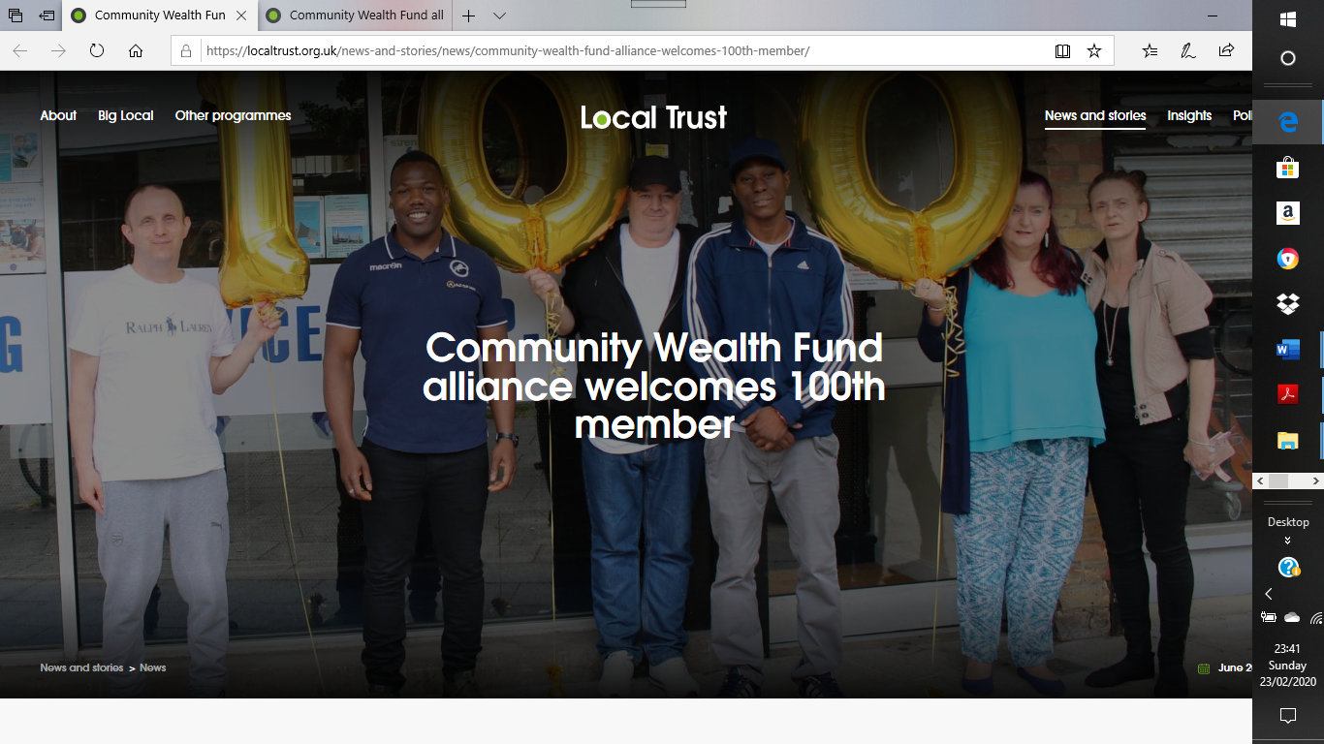
Community Wealth Fund Alliance

Slide 26
Examples of Community Wealth Building overseas
Kigoma, Tanzania is exploring expanding cooperatives and community banking with Preston connection
City of Syndey Council, Australia has adopted a Community Wealth Building approach to procurement
Governor of California has passed legislation to commit to explore establishing a publicly owned bank.
New York City is committed to expand worker owned businesses including to anchor procurement from not for profit hospitals.
European Union’s Make Spend Matter project to enhance impact of procurement by public / anchor institutions to bring additional economic, social and environmental benefits in 7 European cities.
Cincinnati Union Coop movement and 1 Worker 1 Vote with transatlantic dialogue with United Kingdom to replicate concept in UK with major unions.

Slide 27


